Slide 1


SEAG Entrance Assessment 2025 Familiarisation

Slide 2

Welcome to P7 Pupils and Parents
Presentation
Meet some of the Invigilators
Visit your allocated hall/room
See the location of the toilets
Opportunity to clarify concerns with a member of staff

Slide 3
Saturday, 15th and 22nd November 2025
We look forward to welcoming 278 P7 pupils to Coleraine Grammar School for the SEAG Entrance Assessment.
As far as possible, children will be in a hall/room with other children from their primary school.
Pupil Cards are available for download on the SEAG website.

Slide 4
Information Pack
Letter with drop-off/pick-up times and parking zones
Details of the drop-off area/entrance door
Expectations of Parents and Pupils on the Days of the SEAG Entrance Assessment
FAQS for Parents whose Children will sit the SEAG Entrance Assessment 2025
Contingency Planning or ‘What If’ Scenarios - A Guide for Parents/Guardians

Slide 5
Getting Organised - Reminders
Primary school uniform is advised
Pupil Card (download/print from SEAG Dashboard)
Highlighters are permitted but must not be used on the Answer Sheet
Rulers*, calculators, mobile phones, earbuds, watches/ Smartwatches and other electronic devices are not permitted
Clock in the room
Water will be available; candidates are not allowed to bring their own.

Slide 6
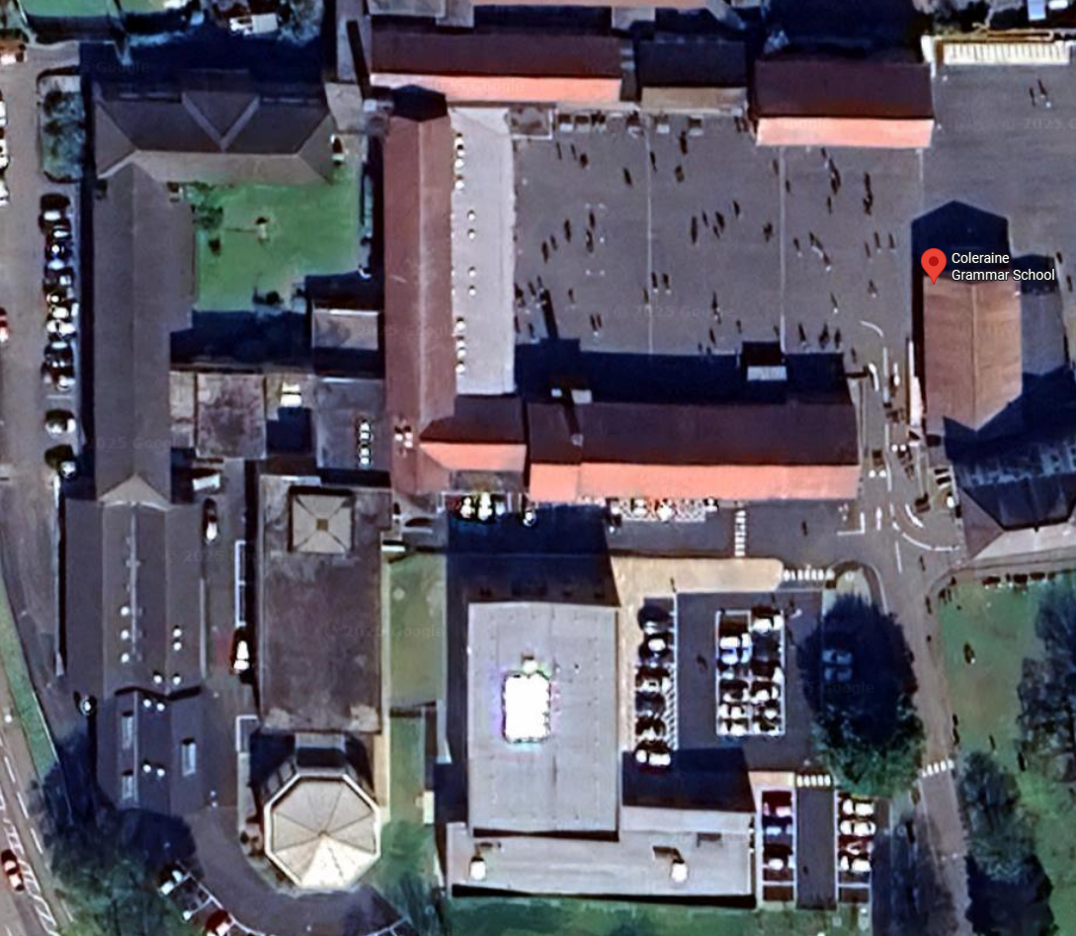


Drop-Off
Drop-off time is 9.15 - 9.30am.
Allow plenty of time for your journey.
The maximum speed is 5mph.
QUAD
Reception
Library
Templeton Auditorium
New Building

Slide 7
Humphreys Hall
Millstrand
Garvagh
Ballysally
Killowen
Harpur’s Hill
Portstewart
Millburn
Carnalridge
Macosquin
Damhead
Hezlett
Portrush
St Malachy’s

Slide 8
Templeton Auditorium
DH Christie
Irish Society

Slide 9
Library
Bush Valley
Carhill
Culcrow
Fletonfleet
Ingham
Kilmoyle
Bushmills
Castleroe
St Colum’s
Ballytober
Knockahollet
Lislagan
Straidbilly
Dunseverick
Ballymoney Model
Gorran

Slide 10
Pupils with Access Arrangements
Pupils with Access Arrangements will be accommodated in the New Building in our Sixth Study Centre & Learning Support Classrooms.

Slide 11
Assessment Locations
QUAD
Reception
Library
Templeton Auditorium
New Building

Slide 12
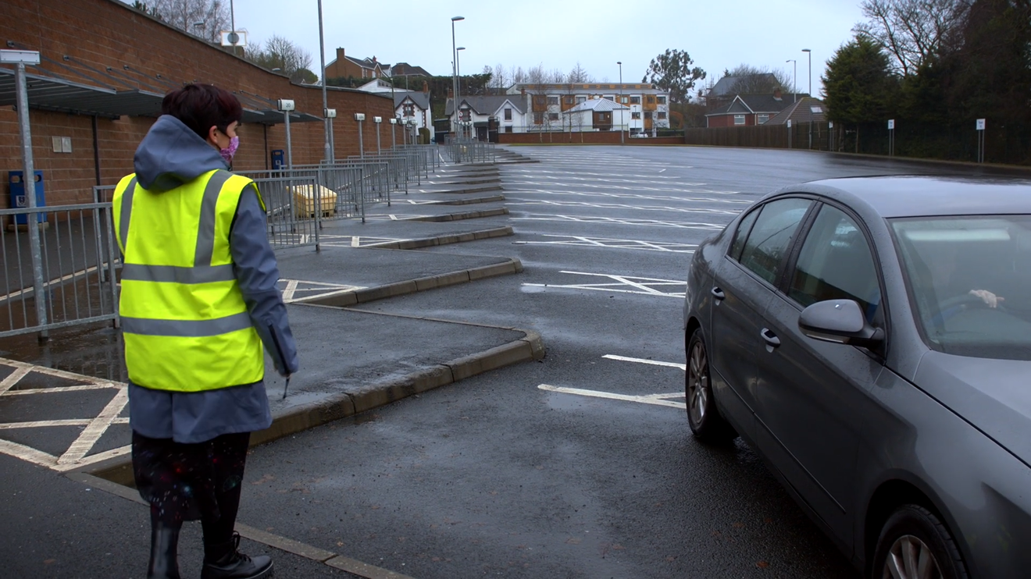
Drop-Off
If travelling by foot, your parent(s) can escort you to and from the drop-off for your zone.
Teachers and Prefects will look after you from here and take you to your designated hall/room.
Parents are not allowed into the designated halls/rooms.

Slide 13
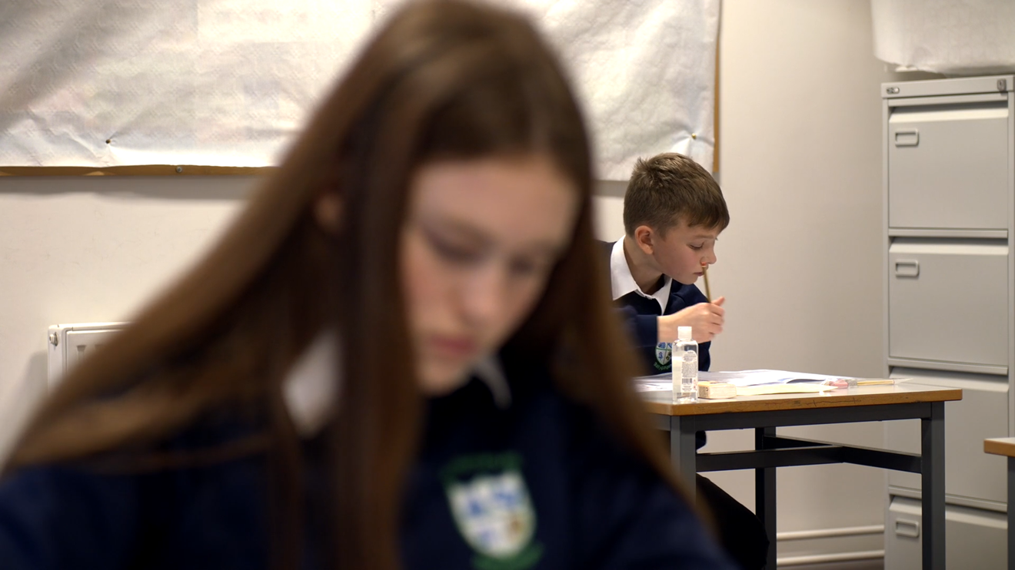
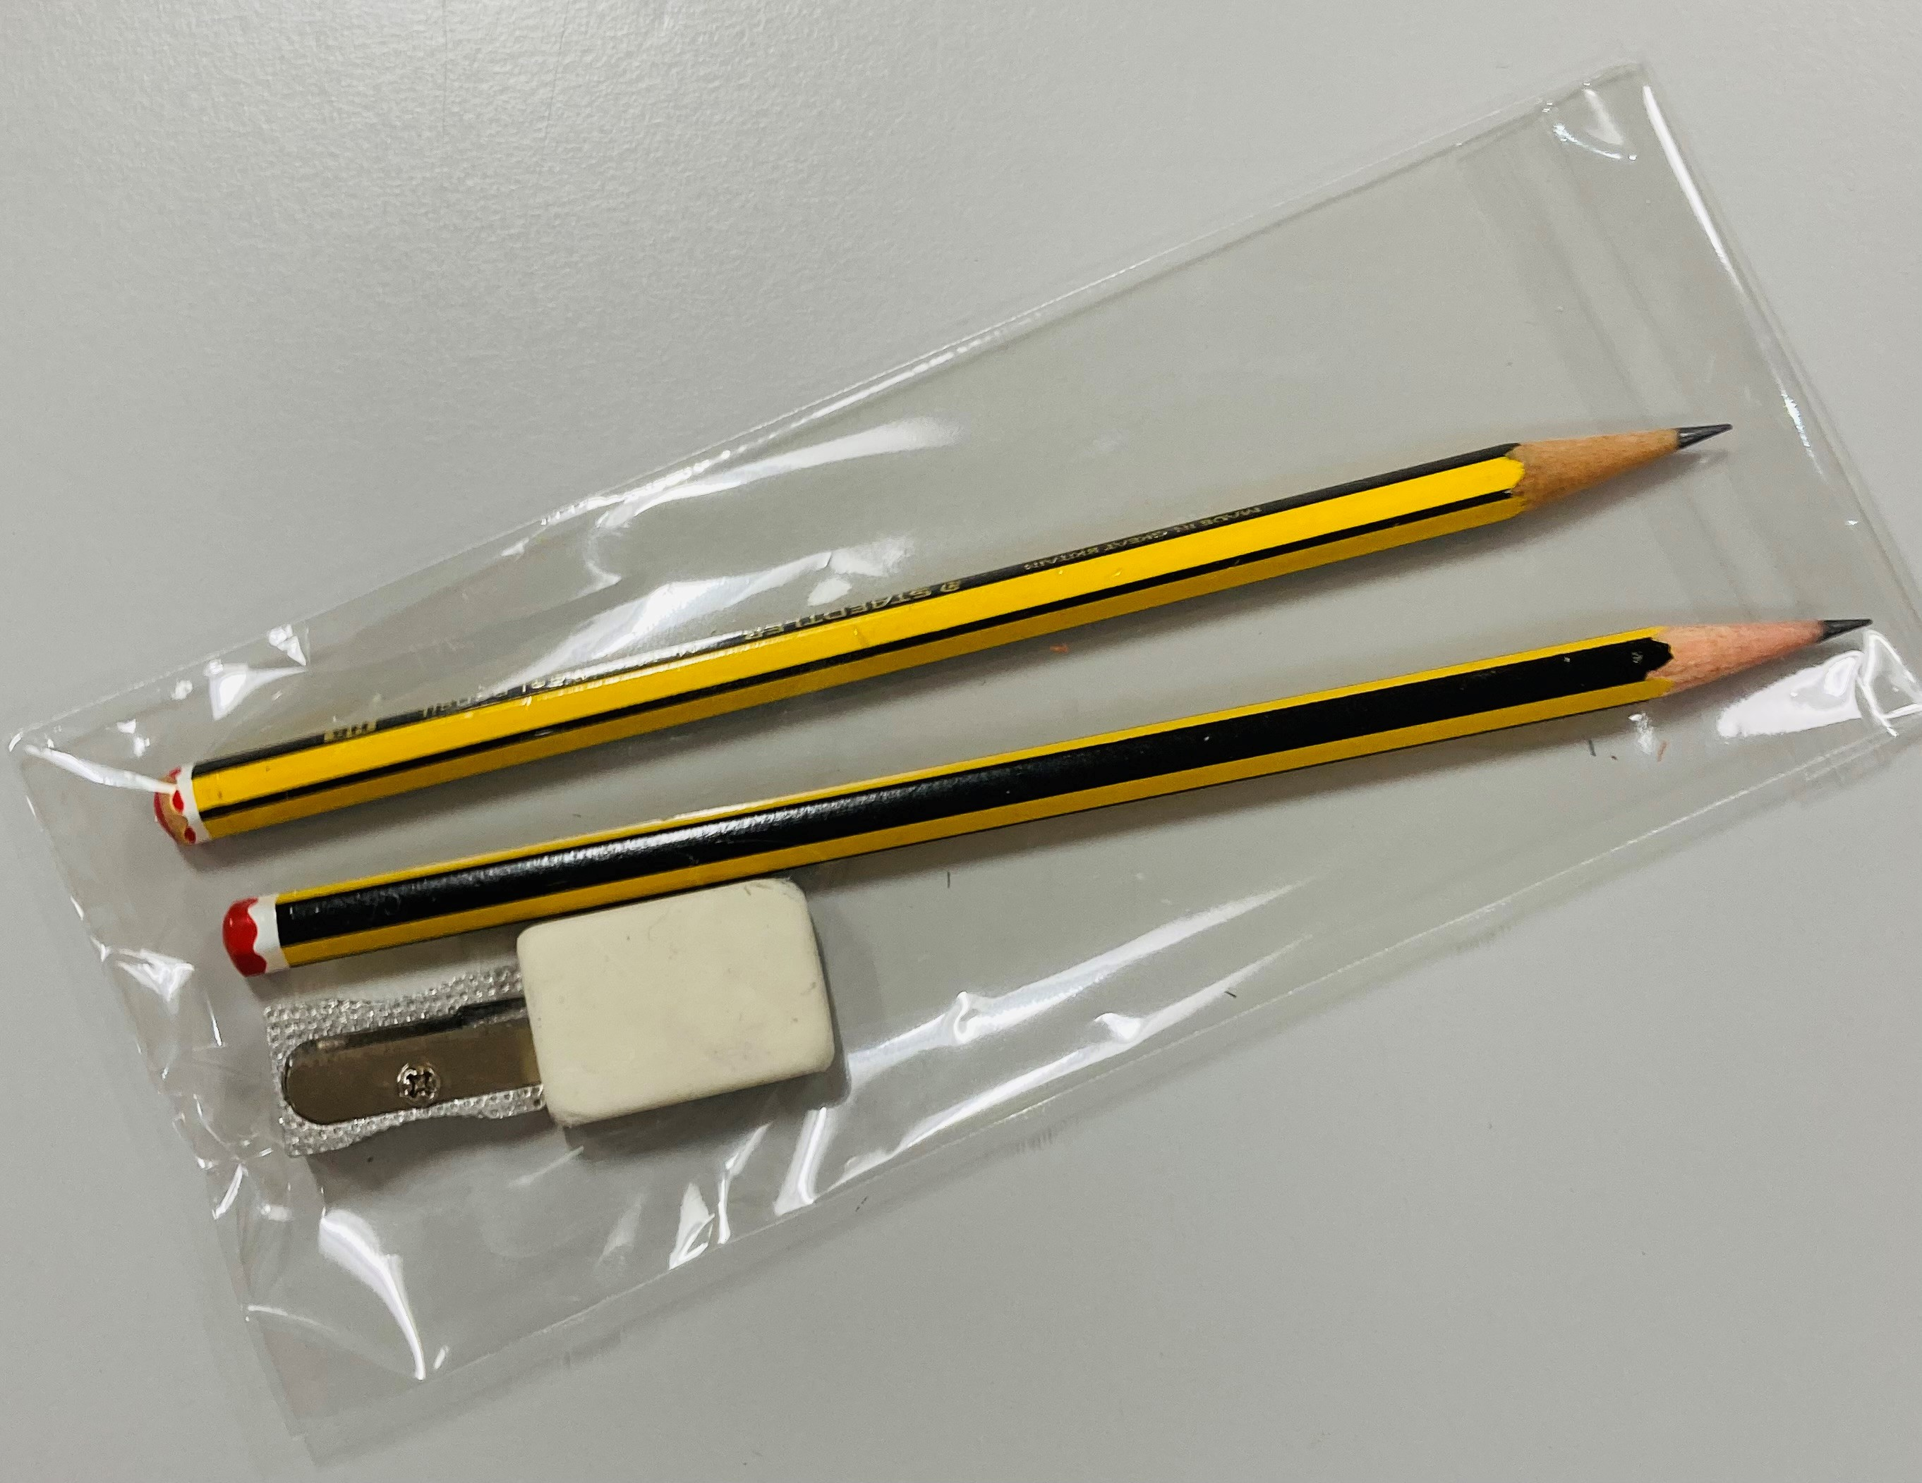
What happens next?
In your room a Prefect will take your Pupil Card and show you to your seat.
There will be two HB pencils and an eraser on your desk, as well as blank paper.
There will be a clock in the room.
You will then have time to get settled and visit the toilet before the Assessment begins.

Slide 14
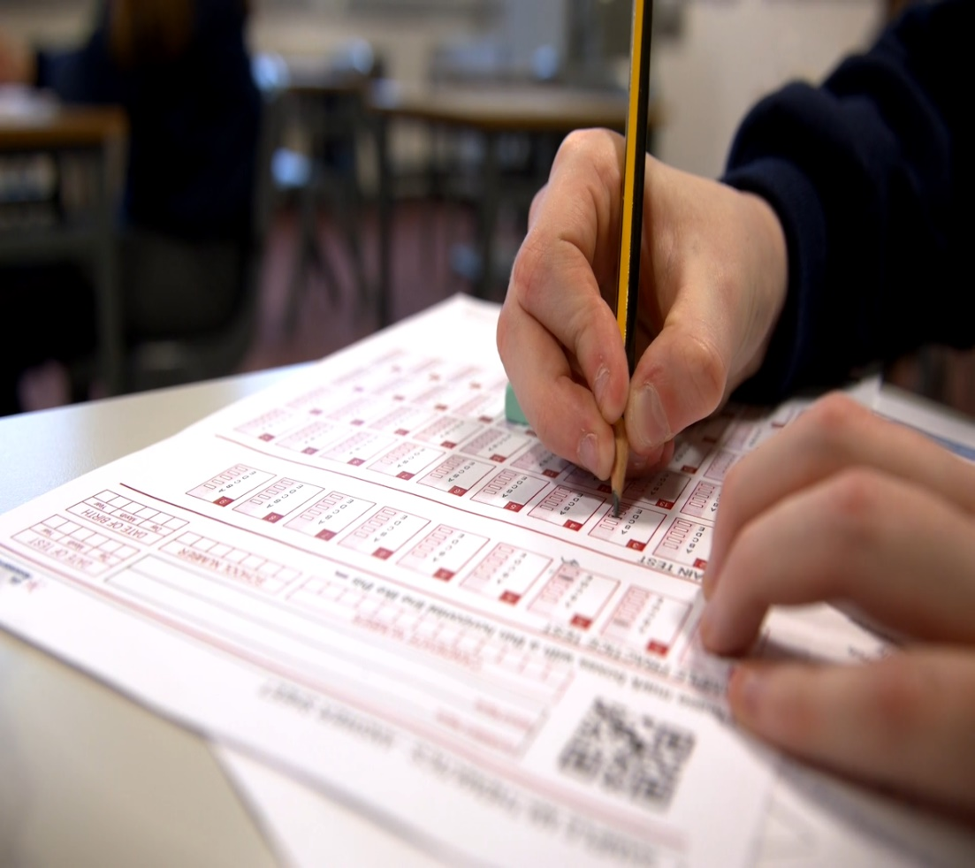
Entrance Assessment - Practice Test Section
Materials issued/checks made
10.00 am: Practice Test Section
5 questions in English (P1 - P5)
5 questions in Maths (P6 - P10)
Guided by Invigilator
P1 - P10 answers are written on the Answer Sheet but aren’t timed and don’t count towards the final mark

Slide 15
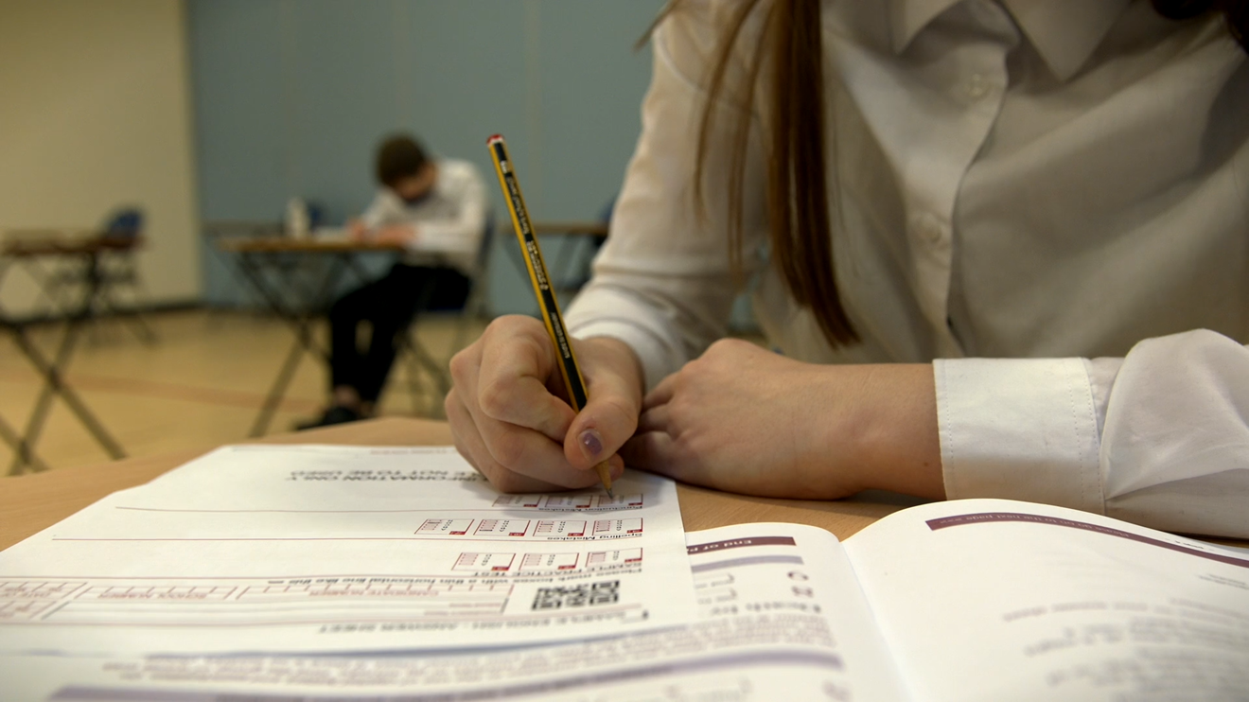
Entrance Assessment - Main Test Section
56 questions in 60 minutes*
English: Q1 - Q28
Maths: Q29 - Q56
Multiple choice and free response (see official SEAG Practice Papers 1 and 2)
Pupils can choose to start with the English questions or the Maths questions
Work quickly and carefully
Extra time is not allowed for a toilet break. It will be allocated for sickness/distress.
* Some pupils with Access Arrangements may have additional time
- normally 75 minutes instead of 60 minutes

Slide 16
Entrance Assessment - Main Test Section - Timings
Pupils are told the start time and finishing time.
The Invigilator will advise all pupils about the time:
- when they are about halfway through
- when they have about 20 minutes left
- when they have about 10 minutes left
After 60* minutes, pupils will be told to stop, put their pencils down and not to talk.
*Timings will differ for pupils with extra time allowed.

Slide 17
Pick-Up
Make sure you know your pick-up time.
11.30 pick up at the spot where you were dropped off.
11.45 for pupils receiving 25% extra time.
Parents are requested to follow the directions of grounds staff and not linger/talk outside the school building.

Slide 18
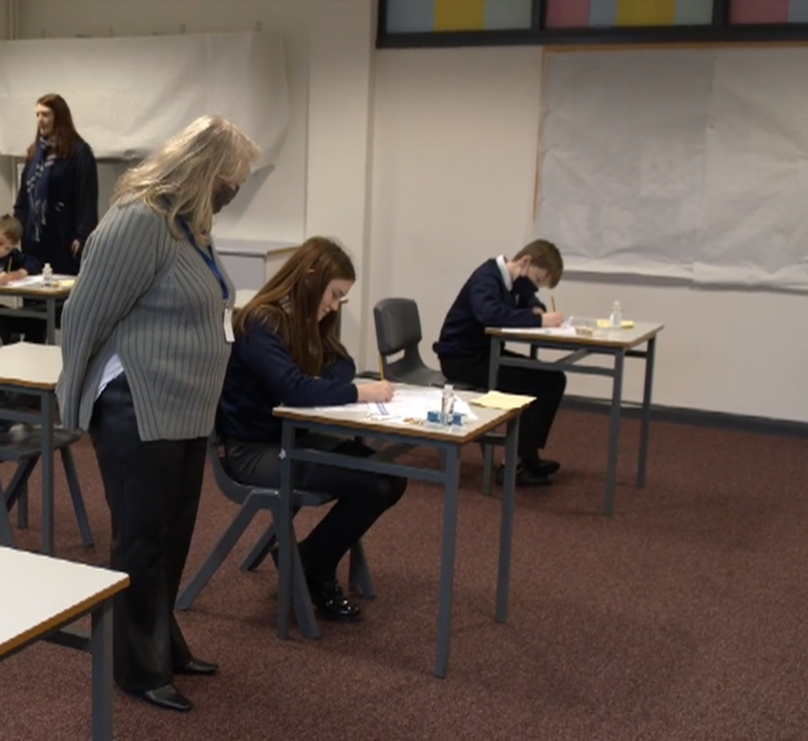
P7 Pupils
Staff and Senior Students have volunteered to help.
Please follow their instructions at all times.
Our job is to help you do your best.

Slide 19

Access Arrangements
Applications were made online.
Decisions made by independent Access Panel.
Communicated to Coleraine Grammar School.
We believe only 12 pupils are waiting for approval of requested Access Arrangements.
Mr M Callaghan is the point of contact in school.

Slide 20
‘What If’ Scenarios
Various ‘What If’ scenarios included in Information Pack covering:
- illness/other valid reason for absence
- late arrival
- withdrawal
- something unexpected e.g., injury
Parents, please keep your phone close by on the two Saturday Assessment mornings AND advise the second emergency contact to do the same
Tel: 028 7034 4331 or Email: mcallaghan910@c2kni.net

Slide 21
Familiarisation
Meet some Invigilators
Visit your allocated hall/room
Speak with Mr Callaghan about Access Arrangements
See the location of the toilets

Slide 22
SEAG Outcomes
Available from Saturday, 25th January 2025 on SEAG website.
- Total Standardised Age Score (TSAS) from 132 - 282
- Band 1 - 6
- English SAS (69 - 141)
- Maths SAS (69 - 141)
- Cohort Percentile Ranking
- A further breakdown of outcomes is also provided, including e.g. number of
questions answered correctly in English, in Maths and in each Paper.

Slide 23

Admissions Process and Criteria
Published in EA Transfer Book available December on-line at www.eani.org.uk
After Special Circumstances and Special Provision, highest 156 scores admitted.
If there is a tie for 156th place:-
Sibling attends CGS;
Random selection.

Slide 24
Special Circumstances/Provision
Special Circumstances:
Medical/other problems which may have affected performance
Special Provision:
Mostly did not sit the test
From outside NI
More than half primary outside NI
Medical/other problems
Follow the Transfer Booklet instructions
Supporting/educational information.

Slide 25
After Results
May meet Primary School Principal
Complete Transfer Application
Attach Special Circumstances/Provision if applicable
Apply to Coleraine Grammar School

Slide 26
Open Night
Open Night will be Thursday 22nd January 2026 from 6.30pm to 9.00pm.
Further information will be published in January 2026 at www.colerainegrammar.com and on the CGS Facebook page.

Slide 27

We look forward to welcoming you back to Coleraine Grammar School to sit your SEAG Examination on Saturday 15th and 22nd November 2024.

