Slide 1

Coleraine Grammar School
In Scientia Opportunitas
(With knowledge there is opportunity)
Open Night 2025
Dr David Carruthers, Headmaster

Slide 2

Coleraine Grammar School
Year 8, 9, 10 Curriculum
CGS Examination Results
New school buildings & extra-curricular facilities
Pastoral Care, Transition to post-primary
Pupils’ Experiences
Admissions Process 2025
Presentation on www.colerainegrammar.com

Slide 3

CURRICULUM
Chemistry
Physics
Biology
Maths
English
ICT
Key Stage 3
Years 8, 9, 10
RE
LLW
Careers
History
Geography
HE
Technology
Drama
Music
Art
Languages –
French
Spanish
PE
Games

Slide 4

GCSE Results
At least 7 A*- C grades including English and Maths vs NI Grammar Schools
 |  | 2019 | 2020 | 2021 | 2022 | 2023 | 2024
AQE > 104 | CGS Pupils | 95.6% | 96.4% | 97.2% | 98.1% | 97.7% | 96.4%
NI Grammar Average |  | 89.9% | 89.9% | 89.9% | 89.9% | 89.9% | 90.50%

Slide 5
Coleraine Grammar A Level Results 2024
A*- C grades – 88.9% of all grades
19 pupils achieved at least one A* grade;
15 pupils achieved at least 3 A grades
55 pupils achieved at least 1 A* or A grade
Durham, Edinburgh, Glasgow, Imperial, Leeds, Liverpool, Loughborough, Manchester, Newcastle, Nottingham, QUB, Stranmillis, Trinity (Dublin), Ulster, York.
Architecture, Biochemistry, Civil Engineering, Computer Science, Criminology, Dentistry, English, Finance, Law, Mathematics, Medicine, Nursing, Occupational Therapy, Pharmacy, Physics, Psychology, Teaching.
 | CGS (%) | NI Grammar (%) Average 2024
At least 3 A-Levels A*- C | 75.2 | 79.9

Slide 6

Pupil Journeys
 | AQE | GCSEs | A Levels | Ex-Curr | Next
Pupil 1 | 117 | 6A*, 4A, 1B | 2A*, 1A | 2nd XI hockey captain, violin | Pharmacy
Pupil 2 | 101 | 5A, 5B | 2A*, 1A | 1st XV Rugby | Law
Pupil 3 | 94 | 1A, 4B, 2C, 1D | 2A, Distinction | Football | Computing
Pupil 4 | 93 | 7A*, 3A | 2A*, 1A | Hockey, Choir, Athletics | Optometry

Slide 7
Inspection
Key Findings
The school’s vision is shared by all members of the school community and understood well by the pupils.
The SLT has close oversight of the school’s improvement priorities
All of the teaching observed during the inspection was effective in promoting active learning
The school knows its pupils well

Slide 8

The middle leaders are well informed …. and carry out robust monitoring and evaluation processes
The school celebrates well the pupils’ many successes in sporting, musical and cultural events
Aspects of CGS practice which should be shared more widely include:
how pupil learning profiles allow the school to support their pupils more holistically and effectively
the school’s journey to improve consistency in learning and teaching

Slide 9
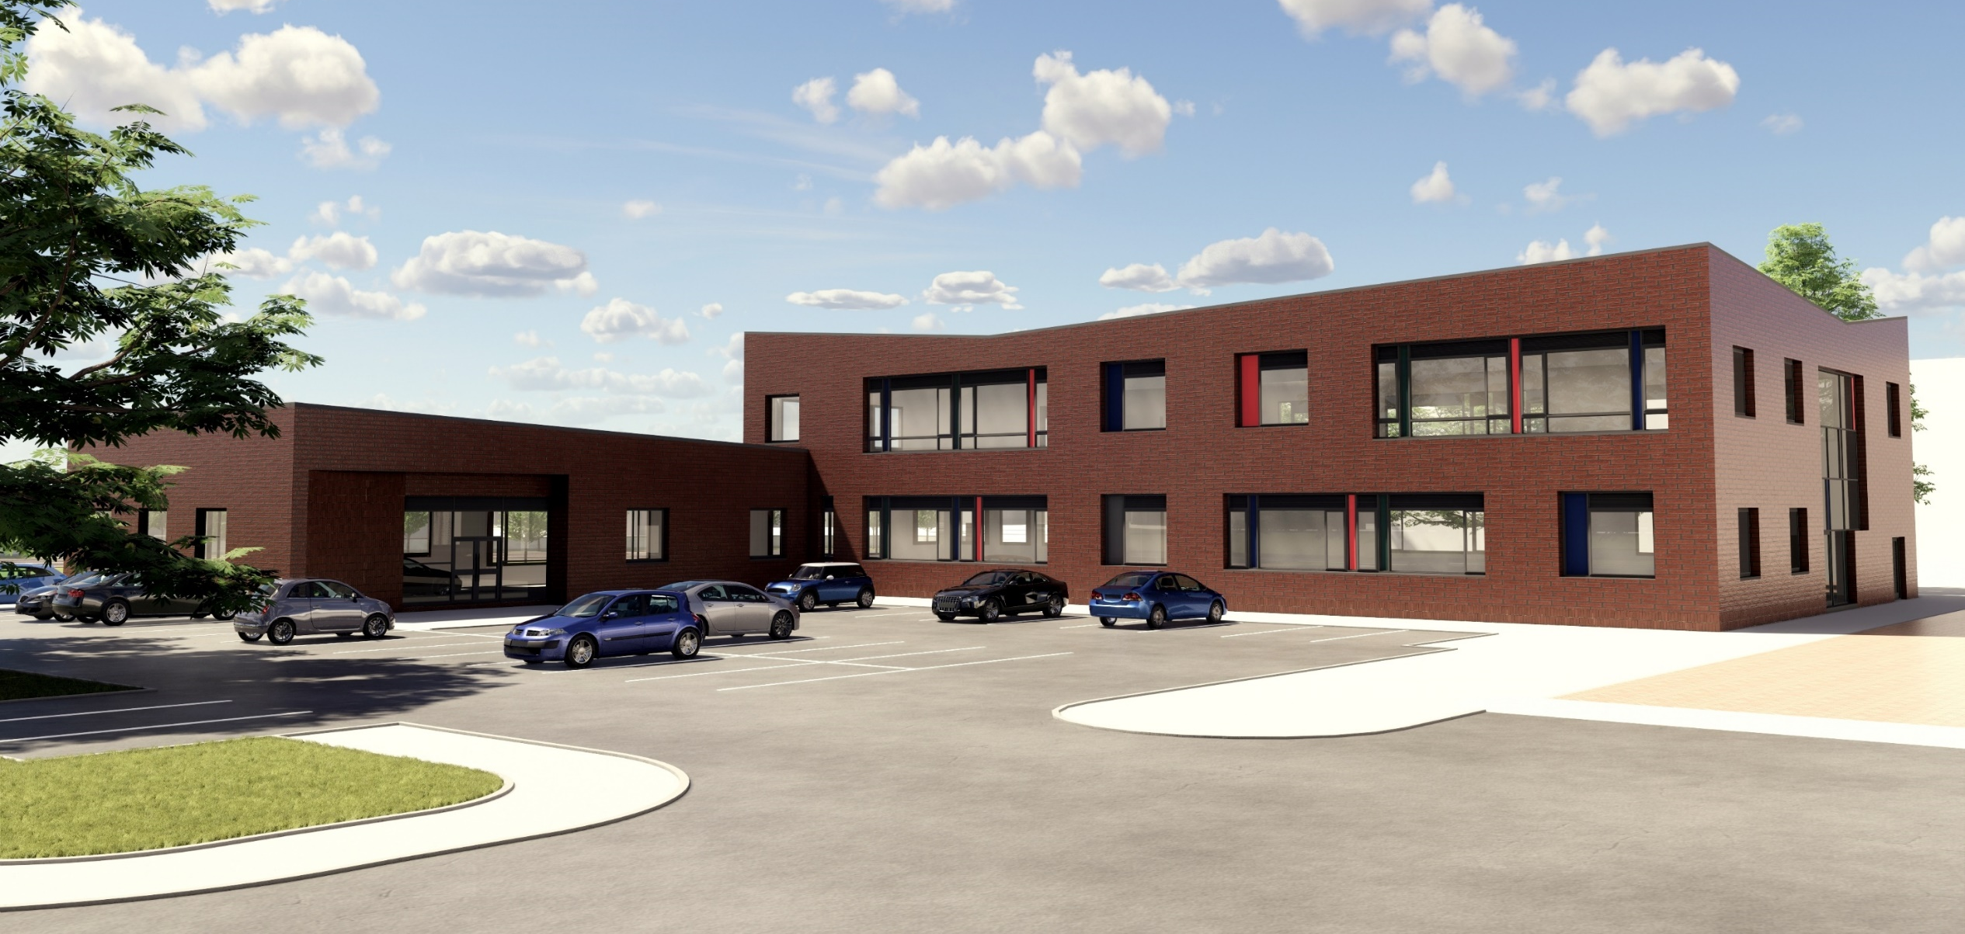

Slide 11
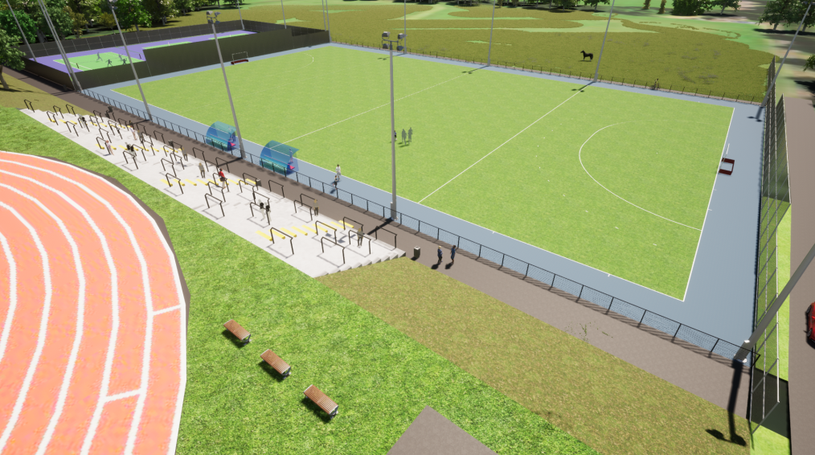

Slide 12

PASTORAL CARE
Headmaster
Vice-Principals and Senior Teacher LR&CR
Pastoral/ Assistant Pastoral Leaders
Class Tutor
Co-ed Class of 26 pupils

Slide 13
Year 8 - Transition
Induction Meeting at CGS in June
Induction Days with Form Tutor in August

Slide 14
Links with Parents
Contact: Pastoral Leader
Pastoral Consultations in October
Academic Consultations in April
Reports throughout the year

Slide 15
Pupil Progress
Academic Progress
Data Reports and Monitoring
Personal Progress
PASS Data
Nurture Room
Involvement in Extra-curricular activities

Slide 16


Extra-Curricular Activities
Debating
Drama
Athletics
Harriers
Rowing
Swimming
Scripture Union
Orchestras &
Choirs
Rugby
Surfing
Volleyball
Hockey
Football
Cricket
Duke of Edinburgh
Tennis
Table-tennis
Angling
Golf
Bar Mock Trial
Badminton

Slide 17

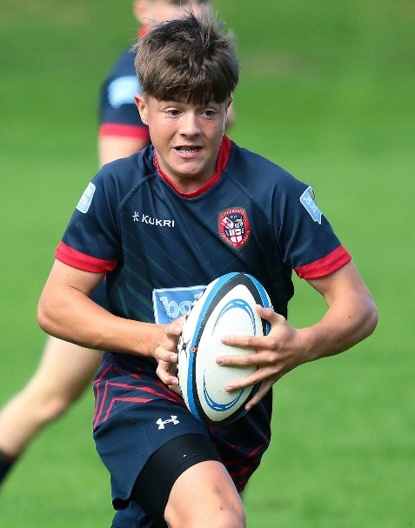
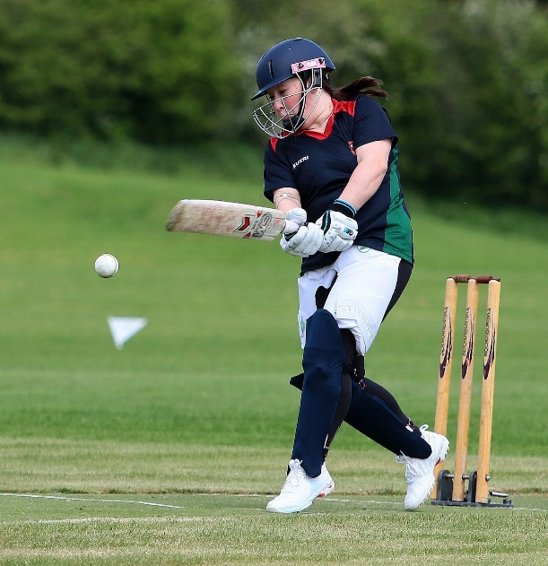

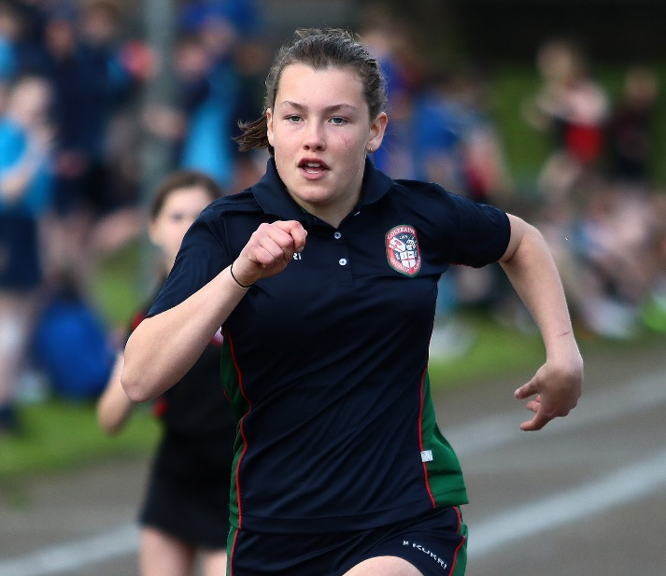
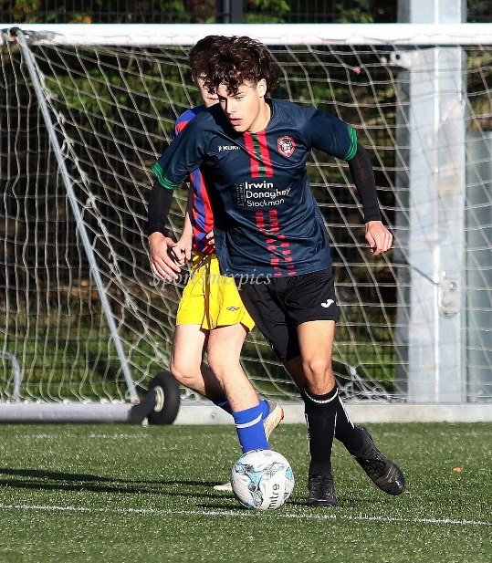

Extra-curricular Activities

Slide 18

Holistic Development of Each Pupil
Pastoral Care
Academic Attainment
Added
Value
Pupil Success
Music & Drama
Sport
Ethos & Values
Learning & Teaching
Attitude & Work

Slide 19
Entrance Criteria
156 Places
Main criterion - SEAG score, applicants in rank order
Consider Special Circumstances/Provision (SC & SP)
Rank all applicants in order of SEAG score
Admit highest 156 scores.
Please see www.eani.org.uk for full details of process, including SC & SP.
Frequently more than 200 applicants for 156 places

Slide 20
Entrance Criteria
156 Places
Main criterion - SEAG score, applicants in rank order
Tie-breaker criteria – only used for the 156th place -
Has brother or sister (child of the family) at CGS.
Random selection.
Please see www.eani.org.uk for full details of process

Slide 21
Change from AQE to SEAG
Scores | Minimum | Average | Maximum
AQE | - | 103 | 130
SEAG | 138 | 200 | 282
You receive a 3-digit TSAS, 138-282
CGS rank orders these scores to admit 156 pupils

Slide 22
AQE & SEAG Estimated Equivalent Scores 2015-2024
 | Lowest AQE Score | Estimated SEAG Equivalent | Highest AQE Score | Estimated SEAG Equivalent | Average AQE Score | Estimated SEAG Equivalent
2015 | 92 | 181 | 119 | 244 | 102 | 200
2016 | 94 | 185 | 126 | 272 | 104 | 203
2017 | 86 | 173 | 124 | 264 | 102 | 200
2018 | 90 | 177 | 120 | 248 | 102 | 200
2019 | 90 | 177 | 122 | 256 | 101 | 197
2020 | 91 | 179 | 126 | 272 | 102 | 200
2021 | No academic selection due to Covid-19
2022 | 86 | 173 | 124 | 264 | 100 | 195
2023 | 87 | 174 | 128 | 280 | 102 | 200
 | Estimated Lowest AQE Score | SEAG Lowest Score | Estimated Highest AQE Score | SEAG Highest Score | Estimate Average AQE Score | SEAG Average Score
2024 | 92 | 181 | 130 | 282 | 101 | 197

Slide 23
2024 Year 8 Admissions
Increase in cut-off score; AQE 92, SEAG 181.
Increase in highest score; AQE 130, SEAG 282.
Increase in number of higher scores.
Decrease in number of lower scores.
Increase in first preferences; 182

Slide 24
Key Factors
Examination results
Quality of teaching and learning
Pastoral Care
Extra-curricular
Affirmed by Inspection Report and Parents
Year 8 intake
Buildings and facilities

Slide 25
Holistic Development of Each Pupil
Pastoral Care
Academic Attainment
Added
Value
Pupil Success
Music & Drama
Sport
Ethos & Values
Learning & Teaching
Attitude & Work

