Slide 1
Welcome to Coleraine Grammar School
Preparation
For
SEAG Tests
and
Admissions 2024
Dr D Carruthers
Headmaster

Slide 2
Contents
Exam regulations
Admissions Process and Criteria 2024
Notes:
The purpose of the familiarisation process is to provide the opportunity for primary 7 pupils to become familiar with the school environment and the hall or room in which they will sit their SEAG examination.
In this presentation the procedures surrounding the SEAG examinations and the admissions process to Coleraine Grammar School will be outlined.
The examination regulations will be presented and general information will be provided about the examination days – for both pupils and parents.

Slide 3
School | Location
Ballysally Primary School | Humphreys Hall
DH Christie Memorial Primary School | Humphreys Hall
Harpurs Hill Primary School | Humphreys Hall
Hezlett Primary School | Humphreys Hall
Irish Society's Primary School | Humphreys Hall
Killowen Primary School | Humphreys Hall
Macosquin Primary School | Humphreys Hall
Mill Strand Integrated School & Nursery | Humphreys Hall
Millburn Primary School | Templeton
Portrush Primary School | Templeton
Portstewart Primary School | Templeton
Notes:
First, some information about where pupils are taking the tests, and I’ll explain where these venues are as we go through and with a diagram at the end.
With the exception of pupils who have Access Arrangements, pupils from these primary school will be taking the assessments here in the Humphreys Hall and the Templeton through the doors at the back of the Humphreys Hall.
Parents of these pupils - please park either at the Tennis Courts, Boat House or DH Christie Primary School all on the Ballycairn Road (left hand side) and walk up to school with your child.
I’ll say more about Access Arrangements in a few minutes.

Slide 4
Seating Plan for Humphreys Hall Row 1 - closest to stage in the Humphreys Hall
Notes:
Row 1 is closest to the stage in the Humphreys Hall.

Slide 5
Seating Plan for the Templeton Row 1 – facing the Castlerock Road
Notes:
Row 1 is facing the Castlerock Road in the Templeton.

Slide 6
School | Location
Ballycastle Integrated Primary School | Library
Ballymena Primary School | Library
Bushmills Primary School | Library
Bushvalley Primary School | Library
Carnalridge Primary School | Library
Castleroe Controlled Primary School | Library
Culcrow Primary School | Library
Damhead Primary School | Library
Dunseverick Primary School | Library
Eden Primary School | Library
Notes:
Similarly, with the exception of pupils who have Access Arrangements, pupils from the primary schools on this slide and the next slide will be taking the assessments in the school library. You will see the Library to your left when you exit this building.
On the morning of the assessments, please enter school by the main gates and park in the quad (area behind the main reception building).
Please enter the building using the door in the quad to reception, where the library is located on your right hand side.

Slide 7
School | Location
Garvagh Primary School | Library
Gorran Primary School | Library
Leaney Primary School | Library
Lislagan Primary School | Library
St Columba's Primary School | Library
St John's Primary School | Library
St Malachy's Primary School | Library
St Patrick's Primary School | Library
Straidbilly Primary School | Library
Termoncanice Primary School | Library

Slide 8
Seating Plan for the Library Row 1 - facing the Castlerock Road

Slide 9
Access Arrangements
For Example: 25% Extra Time
Study mobile: park in the quad and go directly to the Study mobile.
Room of their own: Park in front of Reception and report to staff there.
See Mrs Smith at Reception after this presentation.
Notes:
A number of pupils have already been granted Access Arrangements by the SEAG Access Committee.
We are using the study mobile or individual rooms for Access Arrangements pupils.
On the morning of the Assessments, if your child is sitting the exam in the Study Mobile, please park in the quad and make your way to the Study Mobile directly. If they have been granted a room of their own by SEAG, please report to Reception to meet their supervisor who will walk them to the assessment room.
Any pupils and parents who have had Access Arrangements approved, or who are expecting these to be approved, should meet Mrs Smith at Reception after this meeting – she will escort you to the Study Mobile to let you see this room.

Slide 10
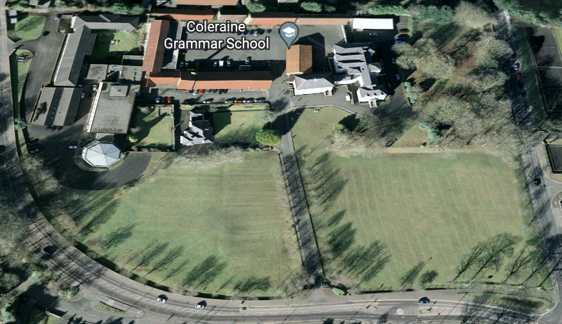
Study Mobile
Quad
Library
Humphreys Hall
Reception
Templeton Auditorium

Slide 11
Seating in the Exam Halls/Rooms
Pupils will be registered on arrival at CGS.
Pupils will be seated in alphabetical order within their Primary School group.
Printed cards with pupil names on them will be set out on the desks, along with the required stationery for completing the tests.
Notes:
This information is to help pupils know where their seat will be in their exam hall or room.
Pupils will be registered as they enter each room/hall.
The pupils will be seated in their primary school groups in each hall and in alphabetical order.
Printed name cards will be on each desk, along with the required stationery for completing the test – two HB pencils, a rubber and some rough work sheets.

Slide 12
SEAG Process
Test dates - Saturday 11^{th &} 25th November 2023.
Pupils will have 60 minutes to answer 56 questions (Extra Time - 75 minutes), with everyone beginning the Practice Test Section at 10am.
SEAG calculate pupil’s standard score.
Results - Saturday 27th January 2024
More information available at www.seagni.co.uk

Slide 13
SEAG Examination Format
The papers assess English and Mathematics and both have an identical format consisting of three Sections:
The First Section, the Practice Test Section, has 5 English followed by 5 Maths questions. These questions are designed to help pupils settle before the Main Test begins.
The Practice Test is not assessed.

Slide 14
The Second Section is the English Main Test.
It has 28 questions(Q1-Q28).
There is a “Punctuation Exercise” containing 5 multiple choice questions,
A “Grammar Exercise” also with 5 multiple choice questions
And a “Spelling Exercise” with 5 multiple choice questions (Q1-Q15).
This is followed by an “English Comprehension”.
Pupils carefully read a passage and are then asked 13 questions; 7 of these are multiple choice (Q16-Q22). The final 6 questions (Q23-Q28) are described as “free response”; the pupil writes the answer to each in the space provided in the Answer Sheet.

Slide 15
The Third Section is the Maths Main Test.
It also has 28 questions (Q29-Q56).
The first 22 Maths questions (Q29-Q50) are multiple choice questions.
The final 6 Maths questions (Q51-Q56) are described as “free response”. For each of these questions the pupil works out the correct answer and writes the answer in the space provided in the Answer Sheet.

Slide 16
Exam Regulations
You should arrive at the school between 9.15am and 9.30am. A large number of pupils will be sitting the tests at CGS, so please allow yourself plenty of time.
If your child arrives after the Entrance Assessment has begun, he/she will not be admitted to the Assessment room.
You should bring your SEAG admissions card.
You should wear school uniform.
On arrival at school you should go to your allocated Hall or room and your named seat.
Stationery, such as pencils, erasers, sheets of blank paper, etc. will be provided.
Rulers are NOT allowed (unless a non graduated reading ruler has been approved as an Access Arrangement.
NO calculators, mobile phones or other electronic devices e.g. iWatches should be brought to the school.
Do NOT bring a watch – there will be a clock in the room.
Notes:
Please ensure that your child arrives in good time – not too early so that they will be getting anxious while they wait– but early enough so that they have time to arrive calmly and settle in to the exam room. Please note there will be a lot of traffic on these mornings around the school.
We suggest that they wear their school uniform because not only does it make it easier for us to look after them, but it also will help them be in the mood to work.
Most pupils tend to wear their uniforms for this reason, however, the most important thing is that they do what makes them feel most comfortable and ready to give of their best.
All stationery will be provided.
No mobile phones or watches of any kind should be brought into the examination rooms by pupils on the day of the examination

Slide 17
Parents
Arrive 9.15 - 9.30am.
Escort pupil to the door of their examination venue.
Go off-site for the duration of the assessment (gates closed).
Collect pupils from 11:30am.
Please be quiet when collecting your child – exams may still be continuing for some pupils.
Notes:
Due to limited car parking space we would request that parents/carers go off-site for the duration of the examination, rather than waiting in their cars.
Some pupils who have been granted extra time will still be working when the majority of children have finished.
Please remind your child that there should be no unnecessary disturbances as they leave the school buildings.

Slide 18
Pupils
Follow teacher’s instructions
No talking
No turning round, no looking at anyone
Work for yourself
End of exam: listen to instructions

Slide 19
Admissions Process and Criteria
Published in EA Transfer Book available December/January on-line: www.eani.org.uk
After Special Circumstances and Special Provision, highest 156 scores admitted
If there is a tie for 156th place:
Sibling attends CGS
Random selection
Notes:
I’ll say more about SC and SP shortly
The admissions process is primarily about SEAG score
We consider claims for SC and SP first and make any appropriate adjustments to scores
Then place SEAG scores in rank order
Admit the highest 156 scores
Apply the non-academic criteria shown only if there is a tie for the 156th place

Slide 20
Special Circumstances/Provision
Special Circumstances:
Medical/other problems which may have affected performance
Special Provision:
Mostly did not sit the test
From outside NI
More than half primary outside NI
Medical/other problems
Follow the Transfer Booklet instructions
Supporting/educational information.
Notes:
Special Circumstances and Special Provision – this is dealt with after the examination – please see the school’s admissions criteria when they are published online by the EA for further details about how to apply for SC or SP if you feel your child’s performance may have been affected by circumstances, or if s/he meets the criteria for SP.

Slide 21
After Results
May meet Primary School Principal
Complete Transfer Application
Attach Special Circumstances/Provision if applicable
Apply to Coleraine Grammar School
September 2015 92
September 2016 94
September 2017 86
September 2018 90
September 2019 90
September 2020 91
September 2021 no academic selection
September 2022 86
September 2023 87
Notes:
After you receive your child’s SEAG score the admissions process is that you
Complete the online transfer form
Attach online details of any claim for SC or SP
Submit your application to CGS
The cut-off scores for all 8 years of academic selection with AQE assessments are shown (no test for admission to September 2021 due to Covid-19).

Slide 22
Summary
156 places allocated by SEAG score
Special Circumstances/Provision
Criteria for tie at 156th place
Results: 27th January 2024
Complete Transfer Application for CGS
Any queries at all please contact
info@colerainegrammar.com
or 028 7034 4331

Slide 23
Coleraine Grammar School
Open Nights: 24th (P6) & 25th (P7) January here at Castlerock Road.
Further information will be published in January at www.colerainegrammar.com
and
CGS Facebook in January 2024

Slide 24
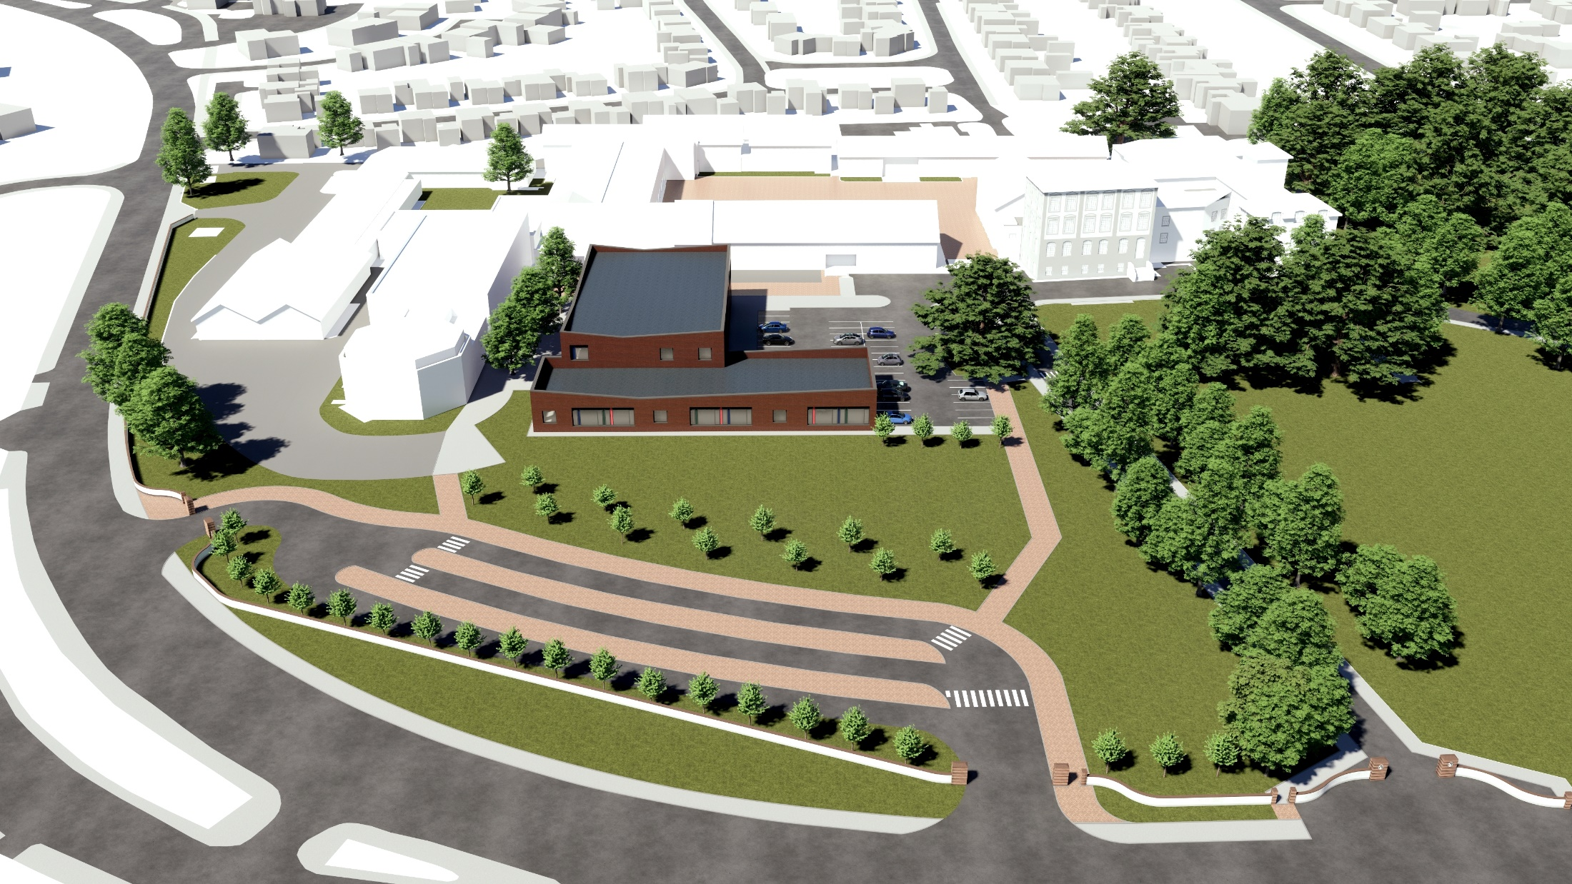

Slide 25
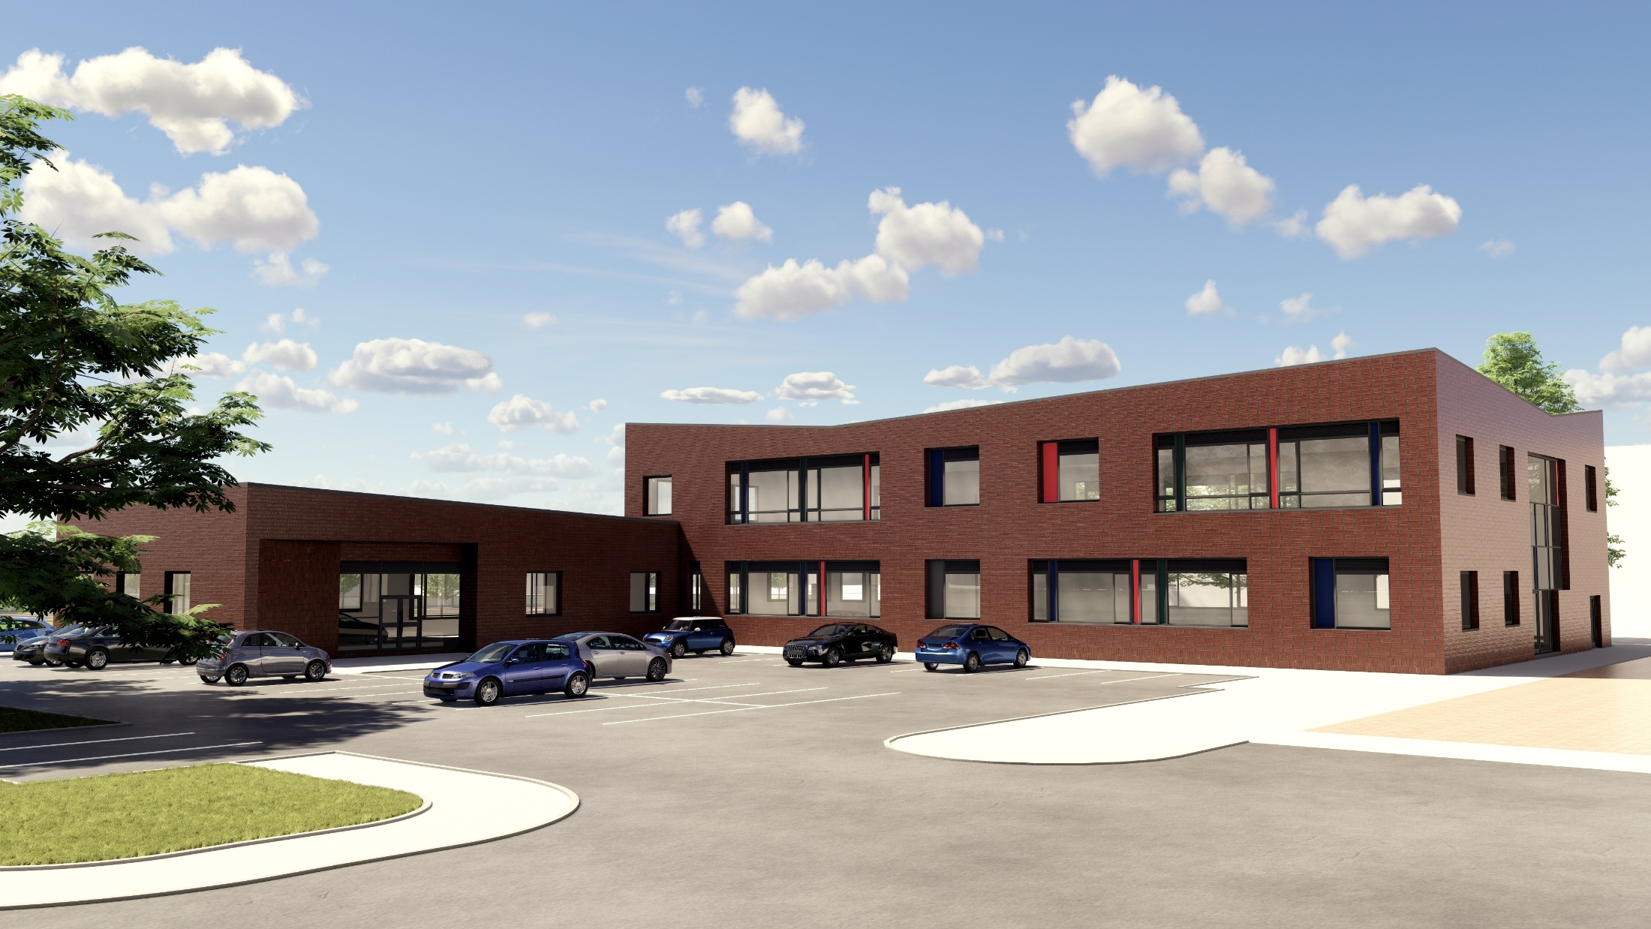

Slide 26
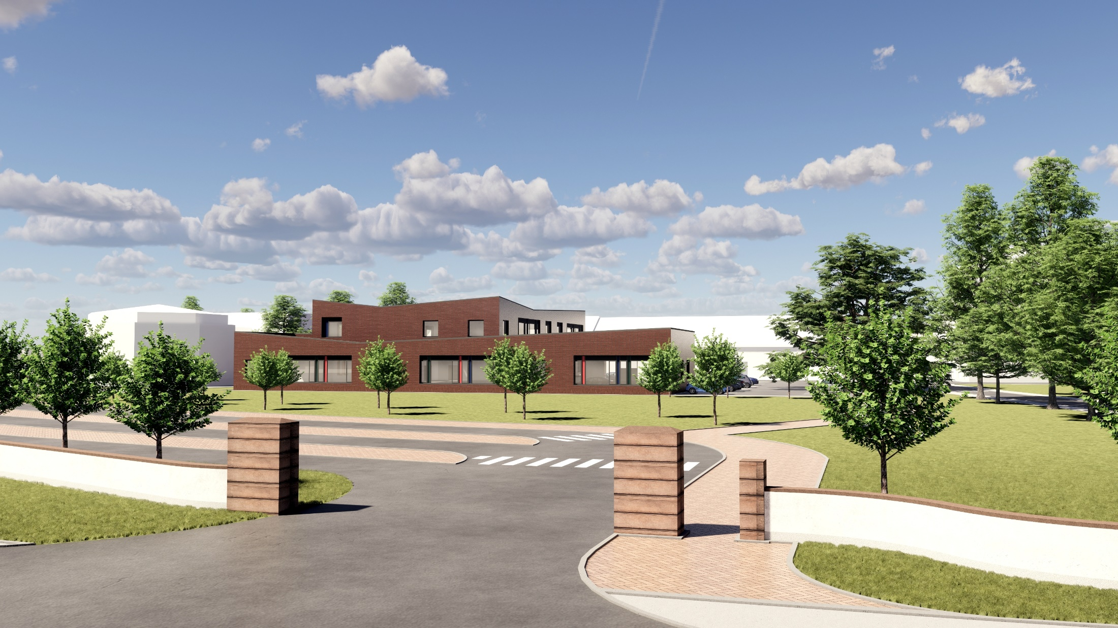

Slide 27
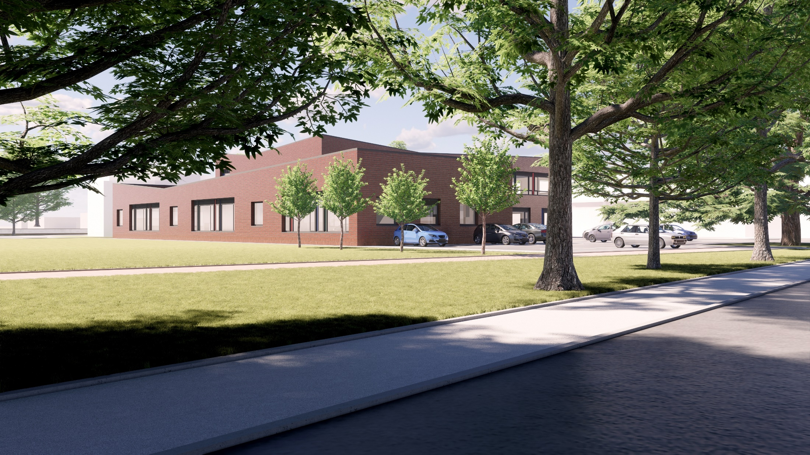

Slide 28
We look forward to welcoming you back to
Coleraine Grammar School Castlerock Road Campus
SEAG Examination
on
Saturday 11th November 2023

